Slide 1
Welcome
Thank you for joining us!

Slide 2
New Officers
Kristen Dickerson

Slide 3
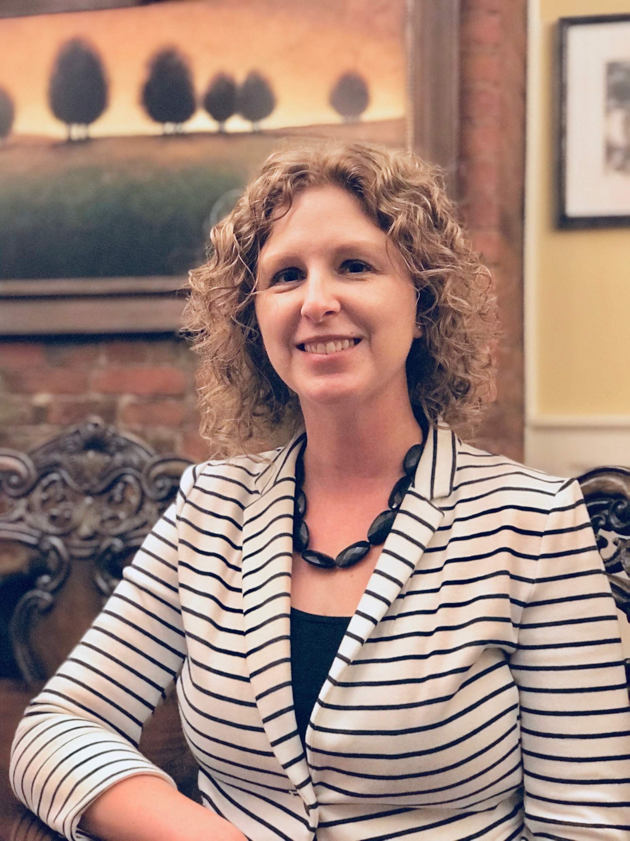
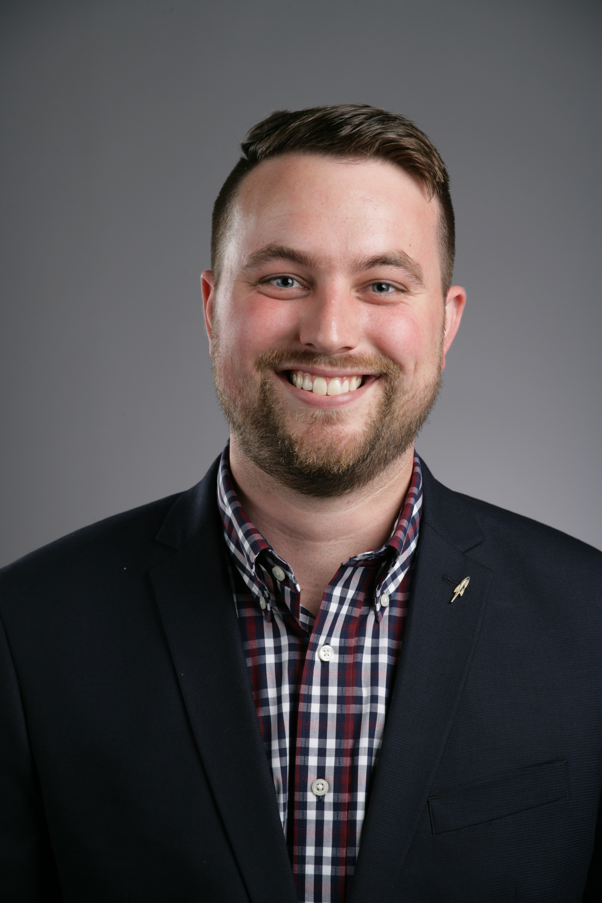
Collin Palmer
President
Director of Admission
The University of Toledo
Kristen Dickerson
Past-President
College & School Counselor
St. Charles Prep

Slide 4
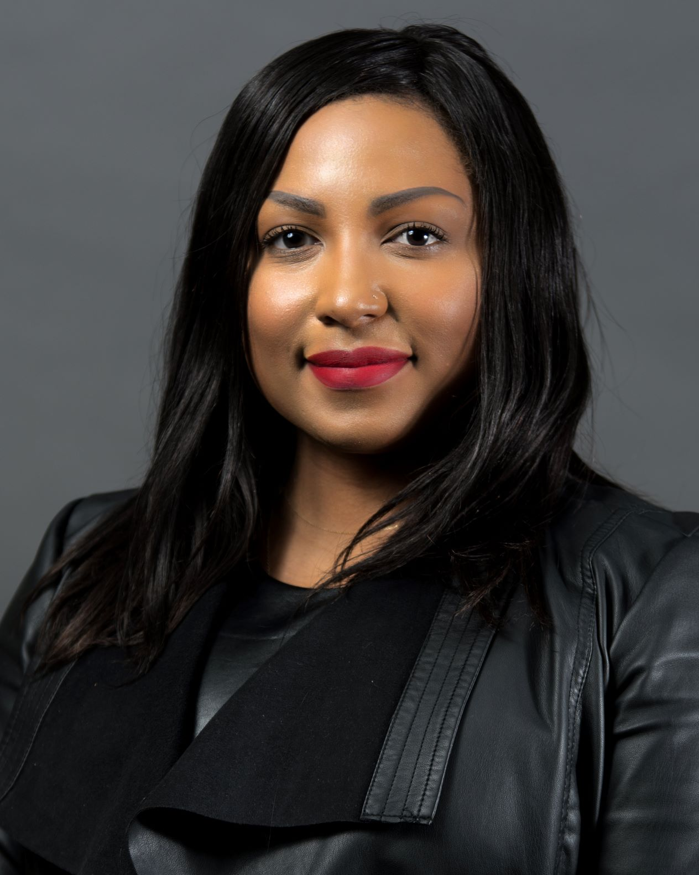
Courtney Johnson-Benson
President-Elect
Senior Assistant Director of Admissions
The University of Akron

Slide 5
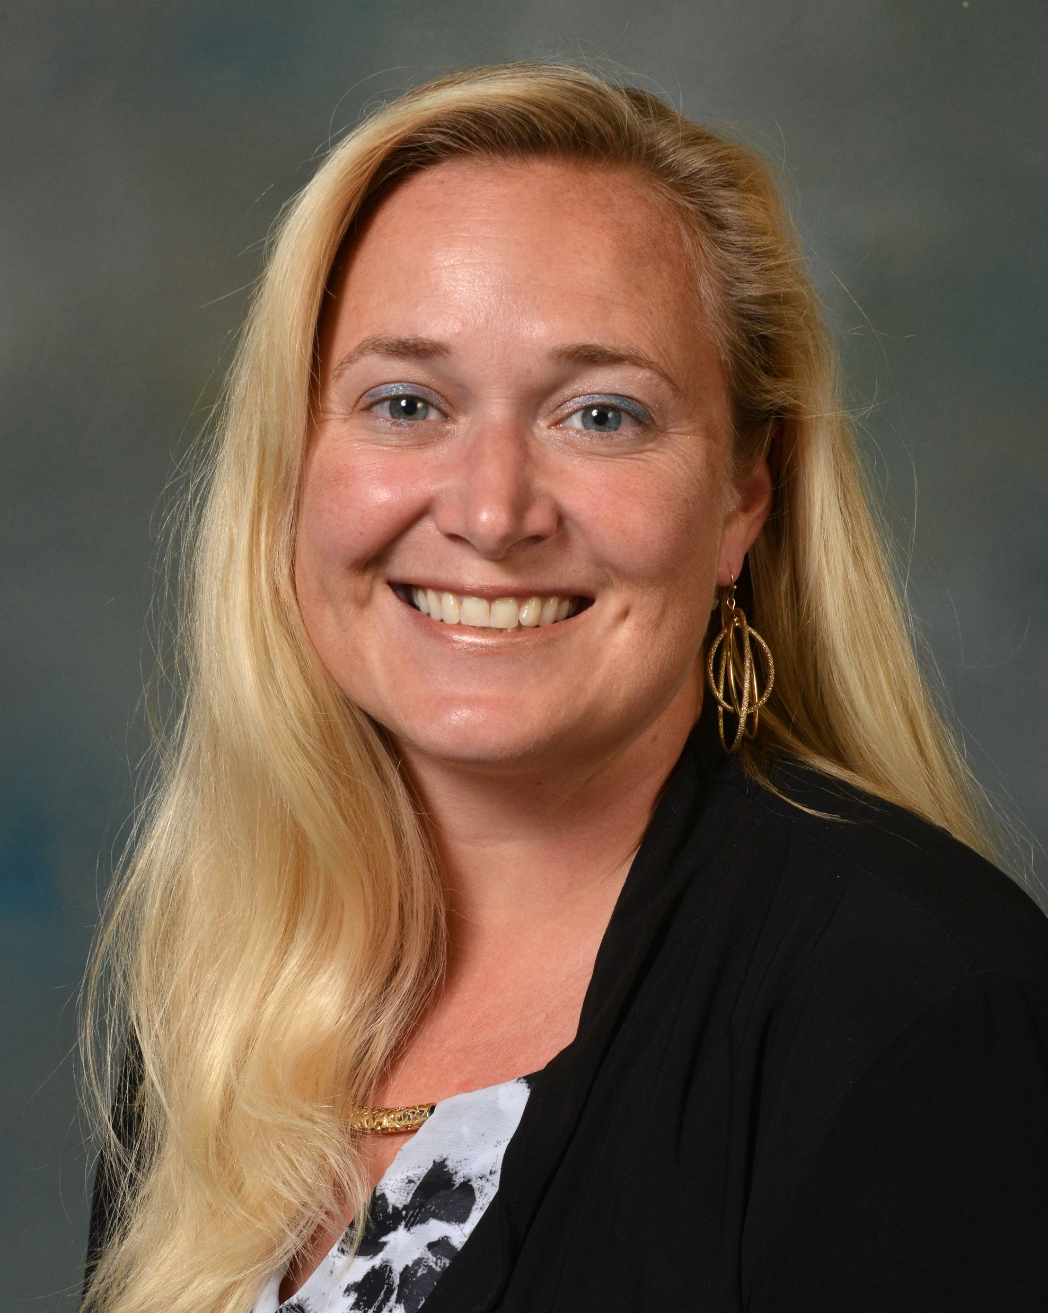
Brandi (Cooper) Cosgrove
Secretary
School Counselor
Granville High School

Slide 6
Adrea Spoon
Treasurer-Elect
Director of Admissions
Bowling Green State University

Slide 7
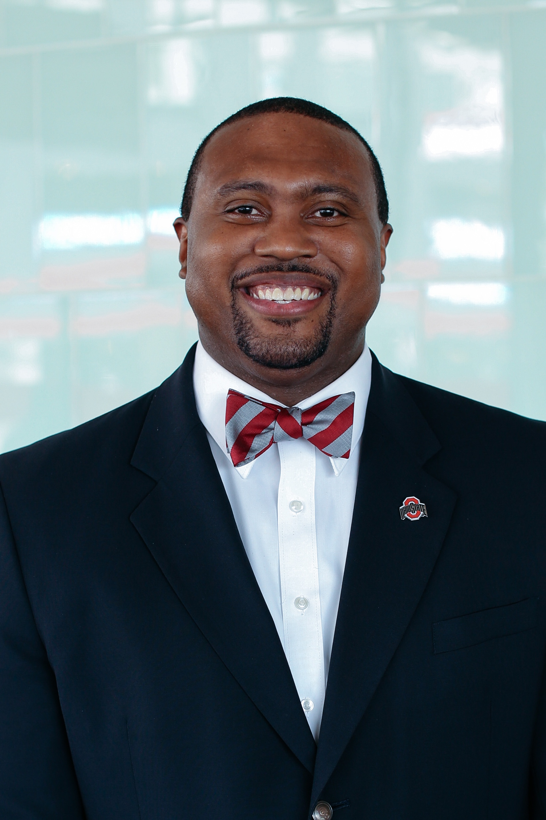
Thomas Giles
Delegate
Assistant Director, Outreach & Recruitment
The Ohio State University

Slide 8
Annual Conference Updates
Courtney Johnson-Benson

Slide 9
2020 Conference Credits for 2021
2021 Conference Location and dates
Marriott Cleveland East
March 14 to 16, 2021
Session Updates

Slide 10
OACAC Membership Meeting
Minneapolis
September, 2020

Slide 11
OACAC Updates
Collin Palmer

Slide 12
Summer Events
Summer Institute
The University of Toledo
Camp College
Case Western Reserve University

Slide 13
Fall Events
Articulation
Plans are in progress
College Fairs
Plans are in progress

Slide 14
OACAC Award Winners!
Nancy Gibson

Slide 15
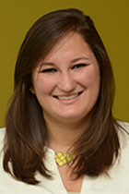
New Member
Award
Kailee Aston
The University of Akron

Slide 16
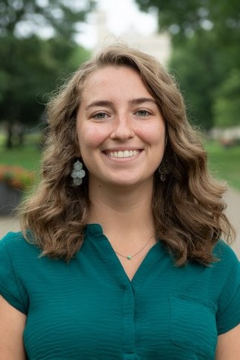
New Member
Award
Isabella Williams
The College of Wooster

Slide 17
Life Member
Award
Candace Boeninger
Ohio University

Slide 18
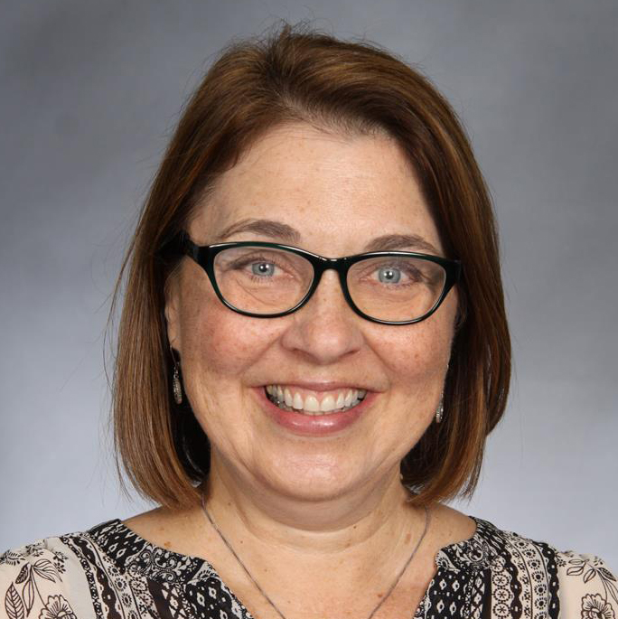
Life Member
Award
Lynn Dembski
Pickerington High School Central

Slide 19
Life Member
Award
Kim Gentile
The University of Akron

Slide 20
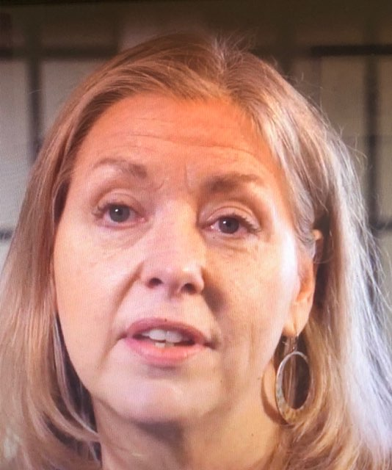
M. Jeanne Talley
Award
Kate Webster
Columbus City Schools

Slide 21
Jack Scott Award
Jeff Stahlman
St. Charles Preparatory School

Slide 22
Charles L. Warren
Scholarship Recipients
Nancy Gibson

Slide 23
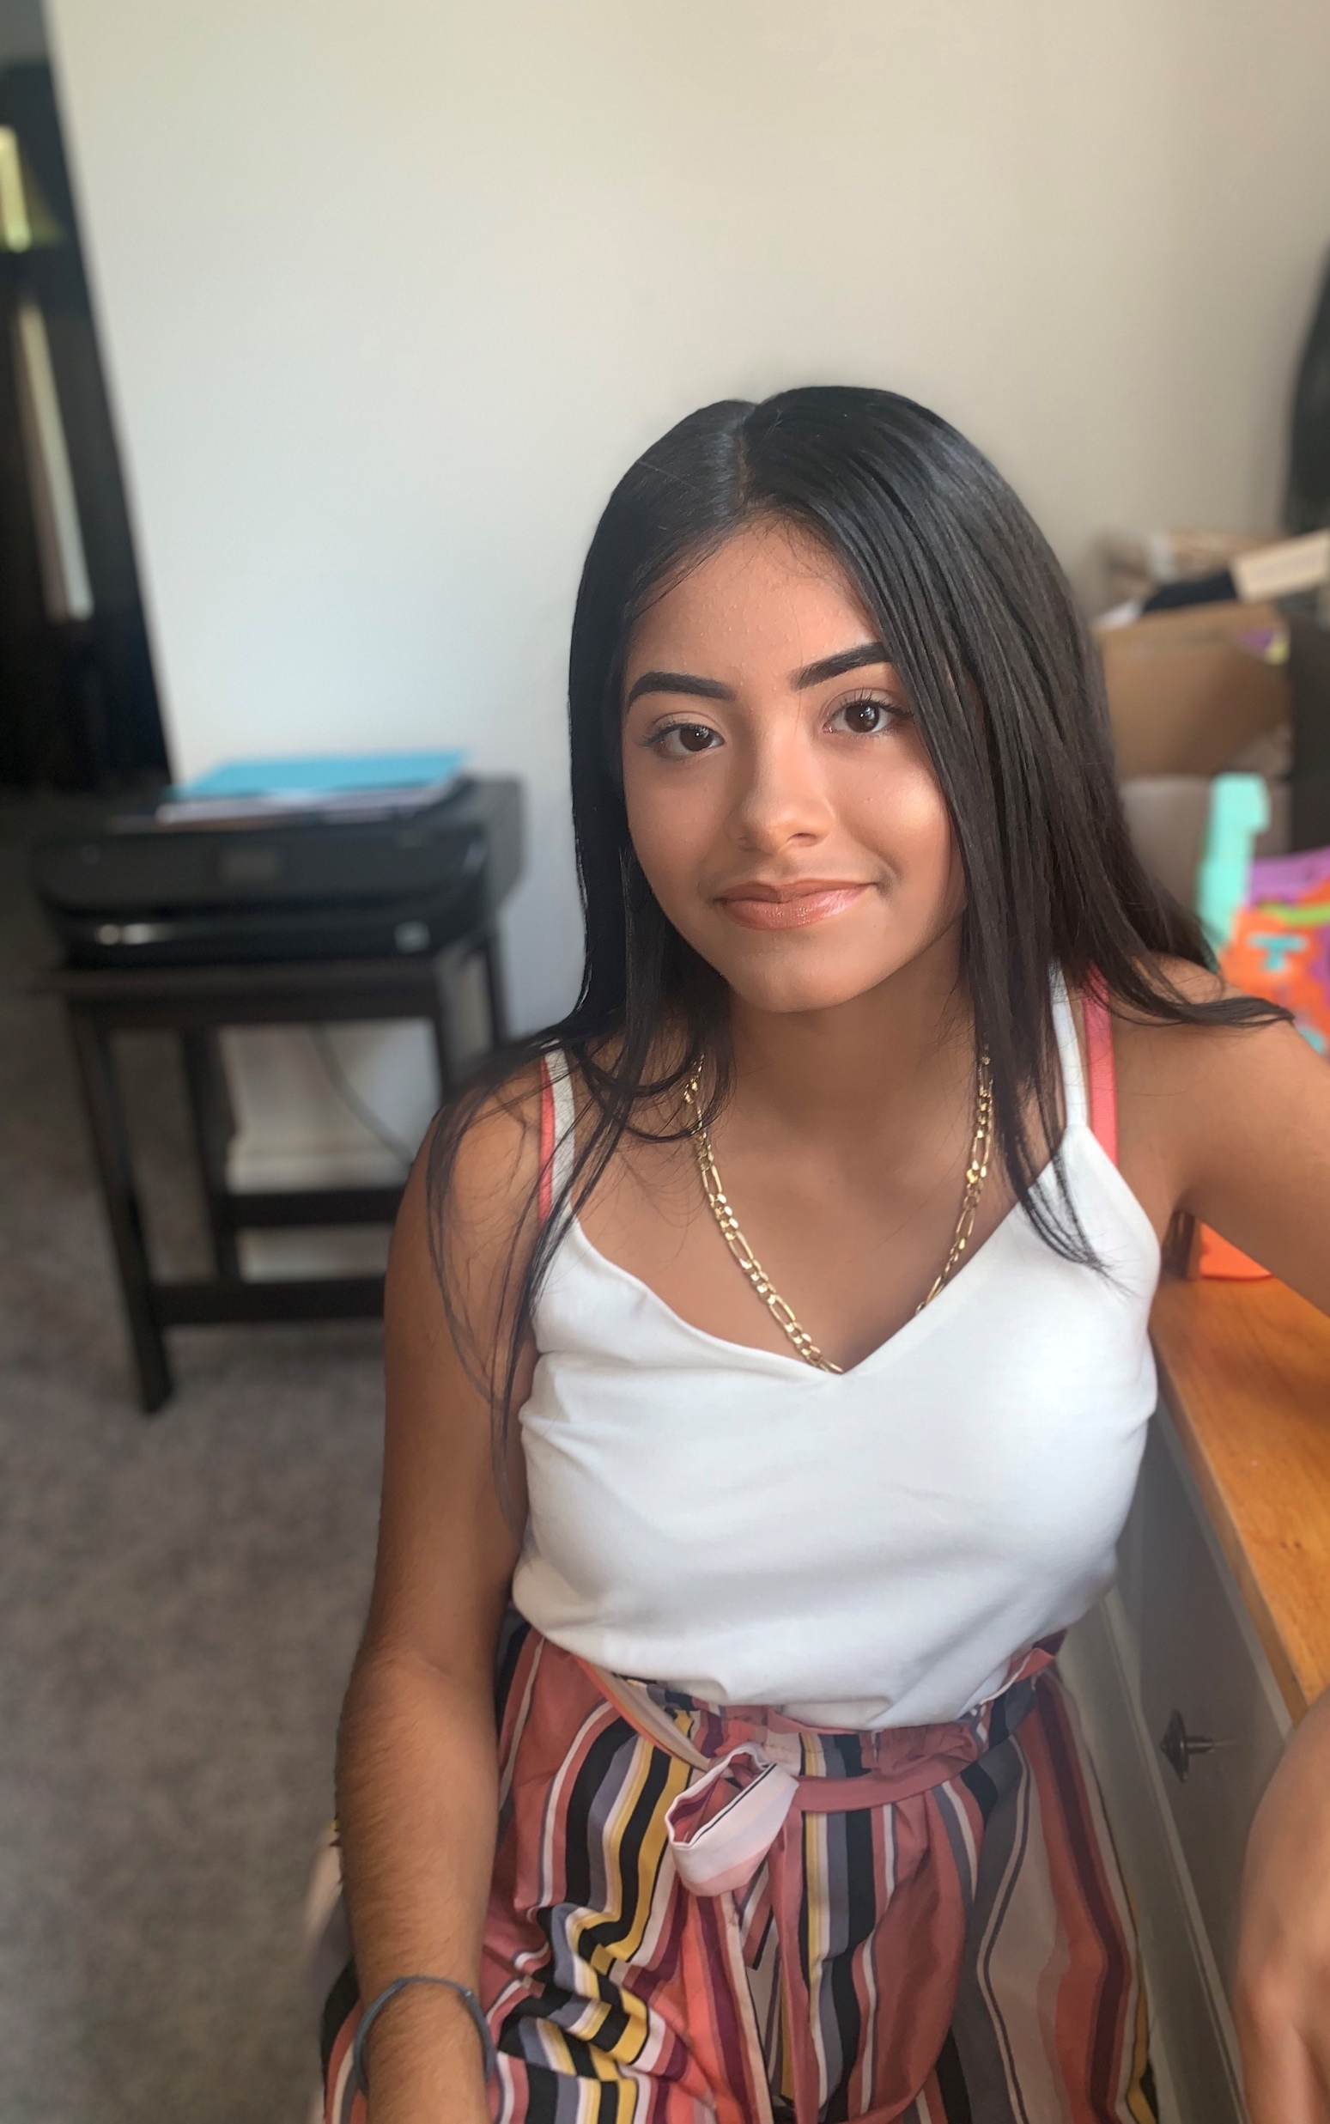
Yaquelin Gomez
Bard High School Early College-West
Still exploring college options

Slide 24
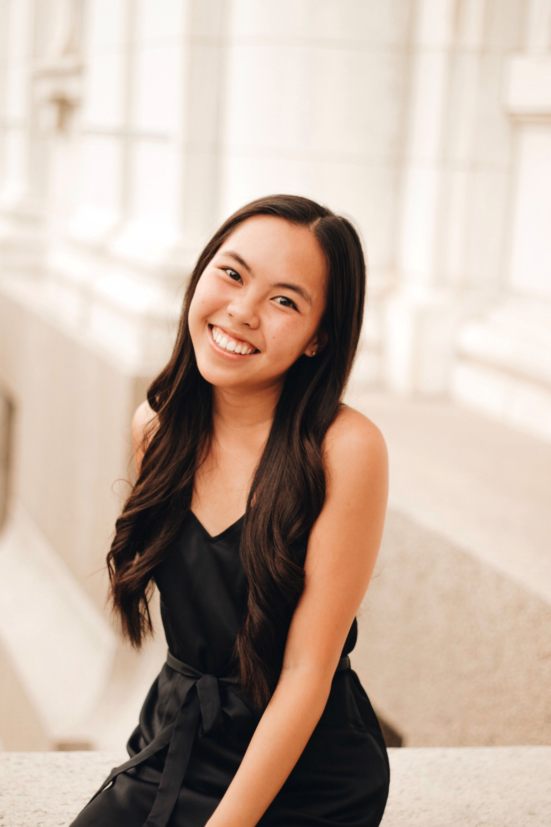
Tiffany Nguyen
Columbus School for Girls
The Ohio State University

Slide 25
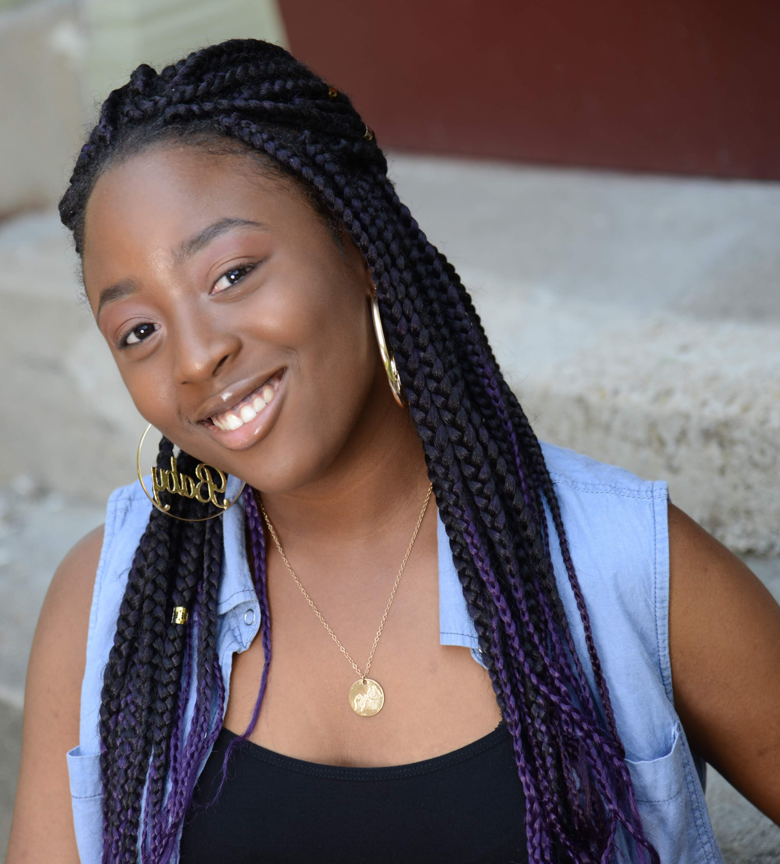
Seyi Agboola
Vandalia-Butler High School
Still exploring college options

Slide 26
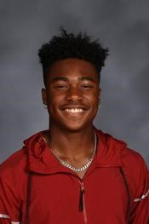
Jared McLean
Pickerington Central High School
Still exploring college options

Slide 27
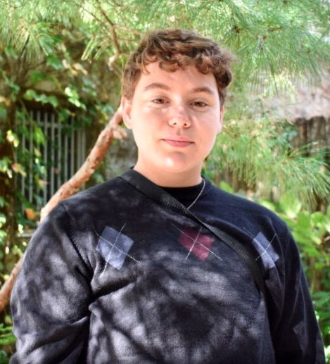
Glen Thompson
Arlington High School
Kent State University

Slide 28
Questions & Answers

Slide 29
Keynote Speaker Introduction
Courtney-Johnson Benson

Slide 30
Jabari Sellars
The Gift, Curse, and
Obligation of 20/20 Vision

